Slide 1
CS-5615: Information Security
Unit-I
Notes:
Speaker Notes:
Explain the concepts in simple language with real-life examples for slide 1.

Slide 2
What is Information ?
Raw Data
│
▼
Processing
│
▼
Meaningful Information
│
▼
Decision Making
Information is processed, organized, and meaningful data that is useful for decision-making.
Information is data that has been processed to provide meaning and value.

Slide 3
What is Security?
Security is the process of protecting valuable assets, information, systems, networks, and computing resources against unauthorized access, disclosure, modification, destruction, or disruption. The primary objective of security is to ensure that information and resources remain protected from both internal and external threats while maintaining their confidentiality, integrity, and availability.
Security is not merely the implementation of locks, passwords, or firewalls. It is a continuous process that involves identifying assets, assessing risks, implementing appropriate controls, monitoring systems, and responding to security incidents.
A complete security framework consists of three fundamental components:
Prevention – Preventing unauthorized activities before they occur.
Detection – Identifying attacks or suspicious activities in real time.
Response and Recovery – Restoring systems and minimizing damage after an incident.

Slide 4
What Requires Protection?
Every organization possesses valuable assets that require protection. These assets include:
Information Assets
Hardware Resources
Software Applications
Communication Networks
Databases
Cloud Infrastructure
Intellectual Property
Financial Records
Customer Information
Human Resources

Slide 5
Why Do We Need Information Security?
In today's digital world, information has become one of the most valuable organizational assets. Almost every organization stores, processes, and transmits sensitive information electronically. As technology advances, cyber threats are also increasing rapidly. Therefore, protecting information has become a critical requirement rather than an option.
Information Security ensures that information remains secure from unauthorized access, misuse, alteration, destruction, and accidental loss throughout its entire lifecycle.

Slide 6
Reasons for Information Security
1. Protection of Sensitive Information
Organizations maintain confidential information such as:
Customer Records
Financial Data
Medical Records
Government Documents
Research Data
Intellectual Property
2. Increasing Cyber Attacks
Modern cyber attacks are becoming more sophisticated.
Common attacks include:
Phishing
Malware
Ransomware
SQL Injection
Password Attacks
Insider Threats
Social Engineering

Slide 7
4. Protection Against Financial Loss
Cyber attacks may result in:
Financial Fraud
Data Recovery Costs
Legal Penalties
Compensation to Customers
Business Revenue Loss
5. Maintaining Customer Trust
Customers share their personal information with organizations expecting it to remain confidential.
Examples include:
Banking Details
Aadhaar Number
PAN Card
Mobile Number
Email Address

Slide 8
6. Legal and Regulatory Compliance
Organizations must comply with security regulations and standards such as:
ISO/IEC 27001
Information Technology Act, 2000 (India)
Digital Personal Data Protection (DPDP) Act, 2023
RBI Cyber Security Guidelines (for Banks)
Consequences of Poor Information Security
Without proper Information Security:
Confidential information may be leaked.
Hackers may steal customer data.
Business operations may stop.
Reputation may be damaged.
Financial losses may occur.
Legal penalties may be imposed.

Slide 9
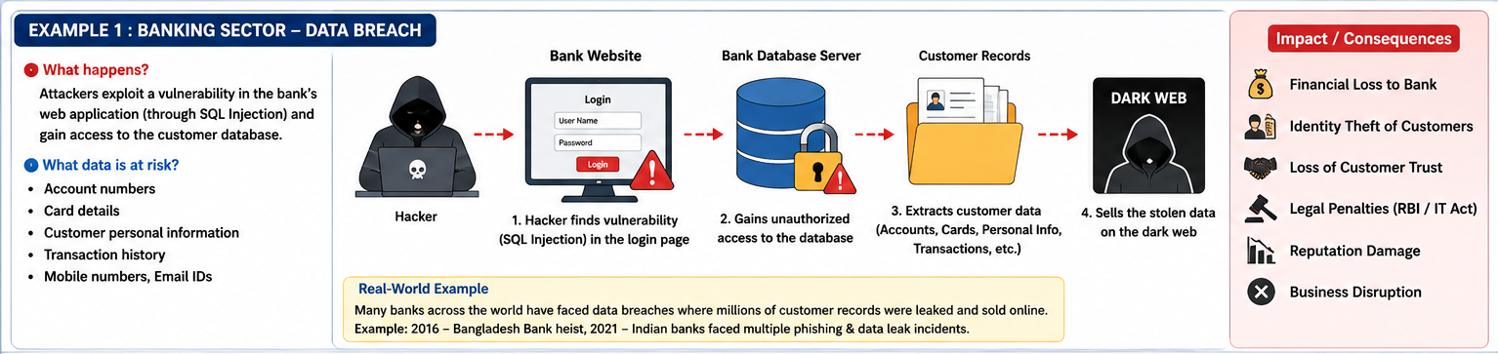
Examples 1 :-

Slide 10
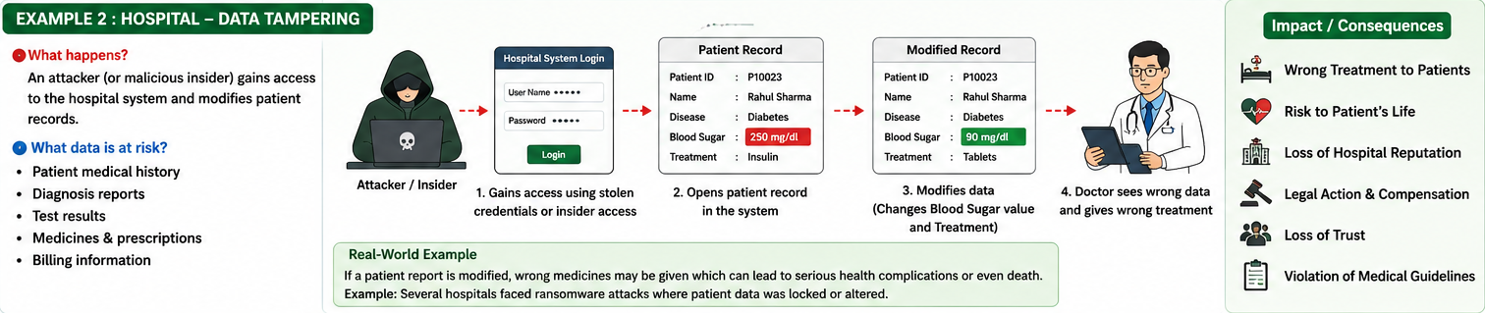
Examples 2 :-

Slide 11
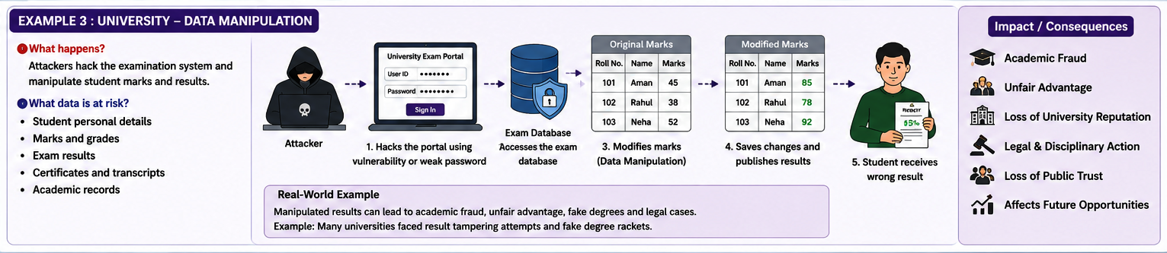
Examples 3 :-

Slide 12
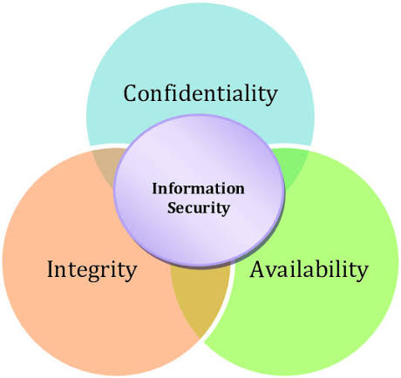
Principle of Information System Security
These three levels justify the principle of information system security.
Confidentiality: Ensures sensitive data is only accessible to authorized individuals. It prevents unauthorized disclosure and is typically implemented through strict access controls, user authentication, and data encryption.
Integrity: Guarantees that information is accurate, reliable, and remains unaltered by unauthorized entities. It protects against both malicious tampering and accidental data modification.
Availability: Ensures that systems, applications, and data are fully operational and accessible to authorized users exactly when they are needed. This requires robust infrastructure and proactive disaster recovery planning.

Slide 13
Confidentiality
Confidentiality is the principle of ensuring that information is accessible only to authorized users and is protected from unauthorized access, disclosure, or leakage. It is the protection of information in the system so that an unauthorized person cannot access it. This type of protection is most important in military and government organizations that need to keep plans and capabilities secret from enemies. However, it can also be useful to businesses that need to protect their proprietary trade secrets from competitors or prevent unauthorized persons from accessing the company's sensitive information (e.g., legal, personal, or medical information). Privacy issues have gained an increasing amount of attention in the past few years, placing the importance of confidentiality on protecting personal information maintained in automated systems by both government agencies and private-sector organizations. Confidentiality must be well-defined, and procedures for maintaining confidentiality must be carefully implemented. A crucial aspect of confidentiality is user identification and authentication. Positive identification of each system user is essential in order to ensure the effectiveness of policies that specify who is allowed access to which data items.
Confidentiality means "keeping information secret from unauthorized persons."

Slide 14
Types of Confidentiality
Data confidentiality: refers to the protection of data stored in computer systems and networks from unauthorized access, use, disclosure, or modification. This is achieved through various methods, such as encryption and access controls.
Network confidentiality: refers to the protection of information transmitted over computer networks from unauthorized access, interception, or tampering. This is achieved through encryption and secure protocols such as SSL/TLS.
End-to-end confidentiality: refers to the protection of information transmitted between two endpoints, such as between a client and a server, from unauthorized access or tampering. This is achieved through encryption and secure protocols.
Application confidentiality: refers to the protection of sensitive information processed and stored by software applications from unauthorized access, use, or modification. This is achieved through user authentication, access controls, and encryption of data stored in the application.
Disk and file confidentiality: refers to the protection of data stored on physical storage devices, such as hard drives, from unauthorized access or theft. This is achieved through encryption, secure storage facilities, and access controls.

Slide 15
Uses of Confidentiality
Encryption: Encrypting sensitive data helps to protect it from unauthorized access and disclosure.
Access control: Confidentiality can be maintained by controlling who has access to sensitive information and limiting access to only those who need it.
Data masking: Data masking is a technique used to obscure sensitive information, such as credit card numbers or social security numbers, to prevent unauthorized access.
Virtual private networks (VPNs): VPNs allow users to securely connect to a network over the internet and protect the confidentiality of their data in transit.
Secure file transfer protocols (SFTPs): SFTPs are used to transfer sensitive data securely over the internet, protecting its confidentiality in transit.
Two-factor authentication: Two-factor authentication helps to ensure that only authorized users have access to sensitive information by requiring a second form of authentication, such as a fingerprint or a one-time code.
Data loss prevention (DLP): DLP is a security measure used to prevent sensitive data from being leaked or lost. It monitors and controls the flow of sensitive data, protecting its confidentiality.

Slide 16
Issues of Confidentiality
Insider threats: Employees and contractors who have access to sensitive information can pose a threat to confidentiality if they intentionally or accidentally disclose it.
Cyberattacks: Hackers and cybercriminals can exploit vulnerabilities in systems and networks to access and steal confidential information.
Social engineering: Social engineers use tactics like phishing and pretexting to trick individuals into revealing sensitive information, compromising its confidentiality.
Human error: Confidential information can be accidentally disclosed through human error, such as sending an email to the wrong recipient or leaving sensitive information in plain sight.
Technical failures: Technical failures, such as hardware failures or data breaches, can result in the loss or exposure of confidential information.
Inadequate security measures: Inadequate security measures, such as weak passwords or outdated encryption algorithms, can make it easier for unauthorized parties to access confidential information.
Legal and regulatory compliance: Confidentiality can be impacted by legal and regulatory requirements, such as data protection laws, that may require the disclosure of sensitive information in certain circumstances.

